Slide 1
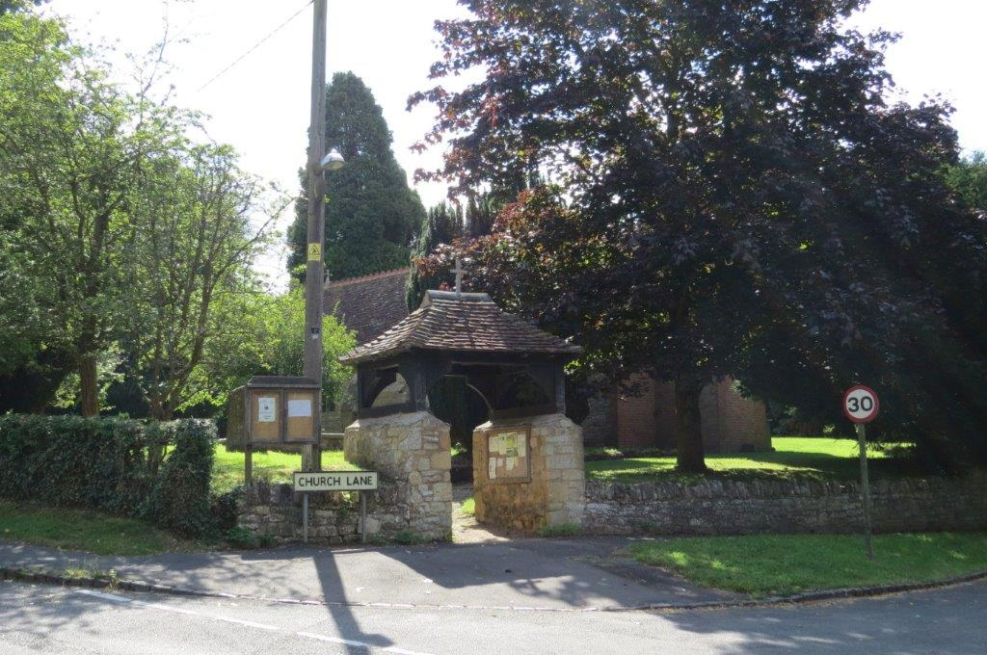
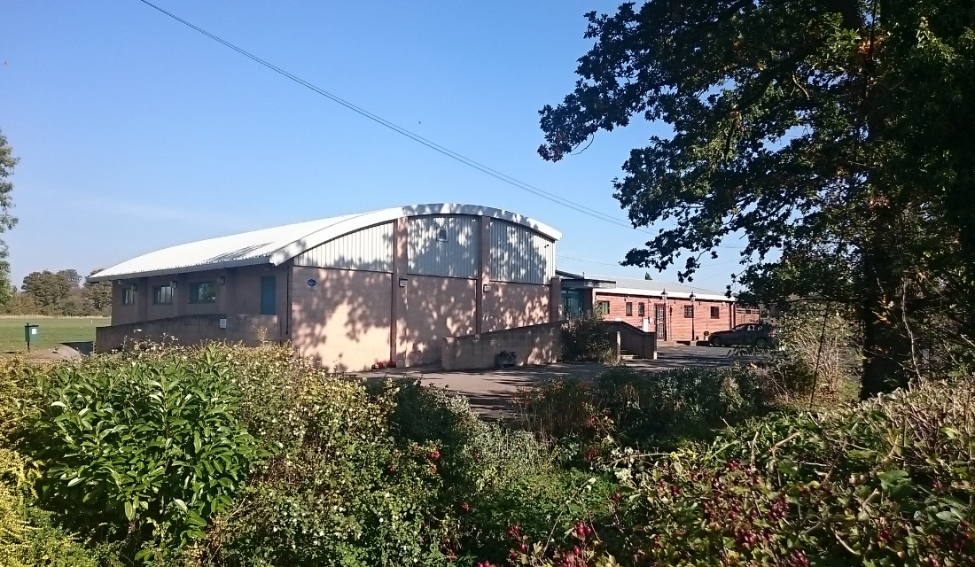

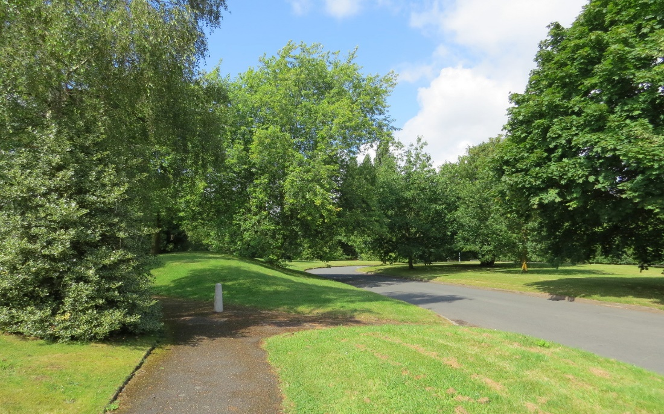

Slide 2

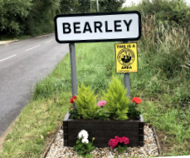
South Warwickshire Local Plan
Public Meeting 25th Jan 2025

Slide 3

SOUTH WARWICKSHIRE LOCAL PLAN
AGENDA
Welcome
Introductions
The big picture - Ian Shenton, S-on-A District Councillor
As it affects Bearley – Pete Delve, Parish Councillor
Q&As – Guy Esnouf, Parish Councillor
Tea, coffee, biscuits, chat & post-it notes
Photography

Slide 4
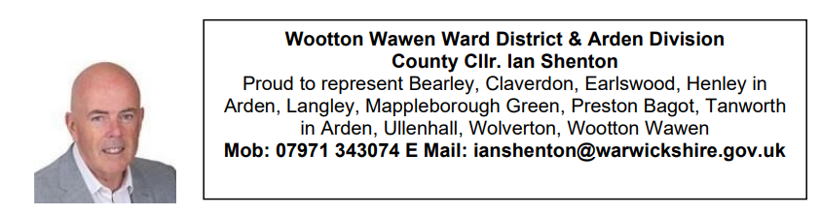

Slide 5


Slide 6
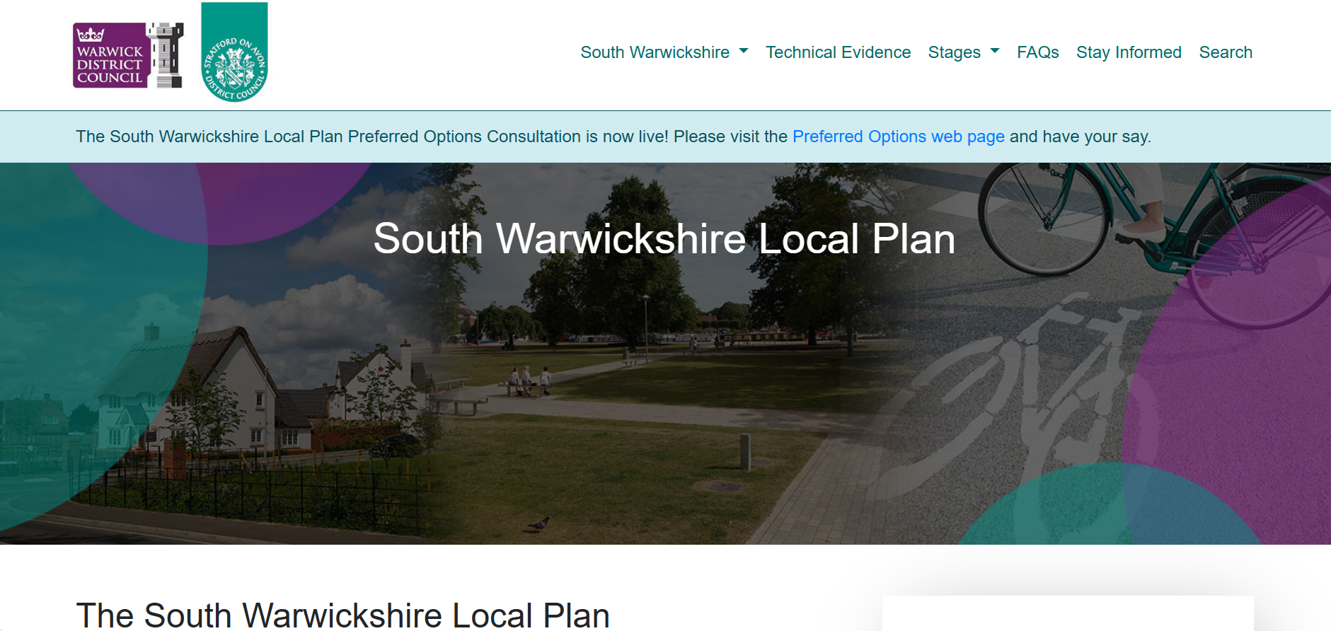

Slide 7
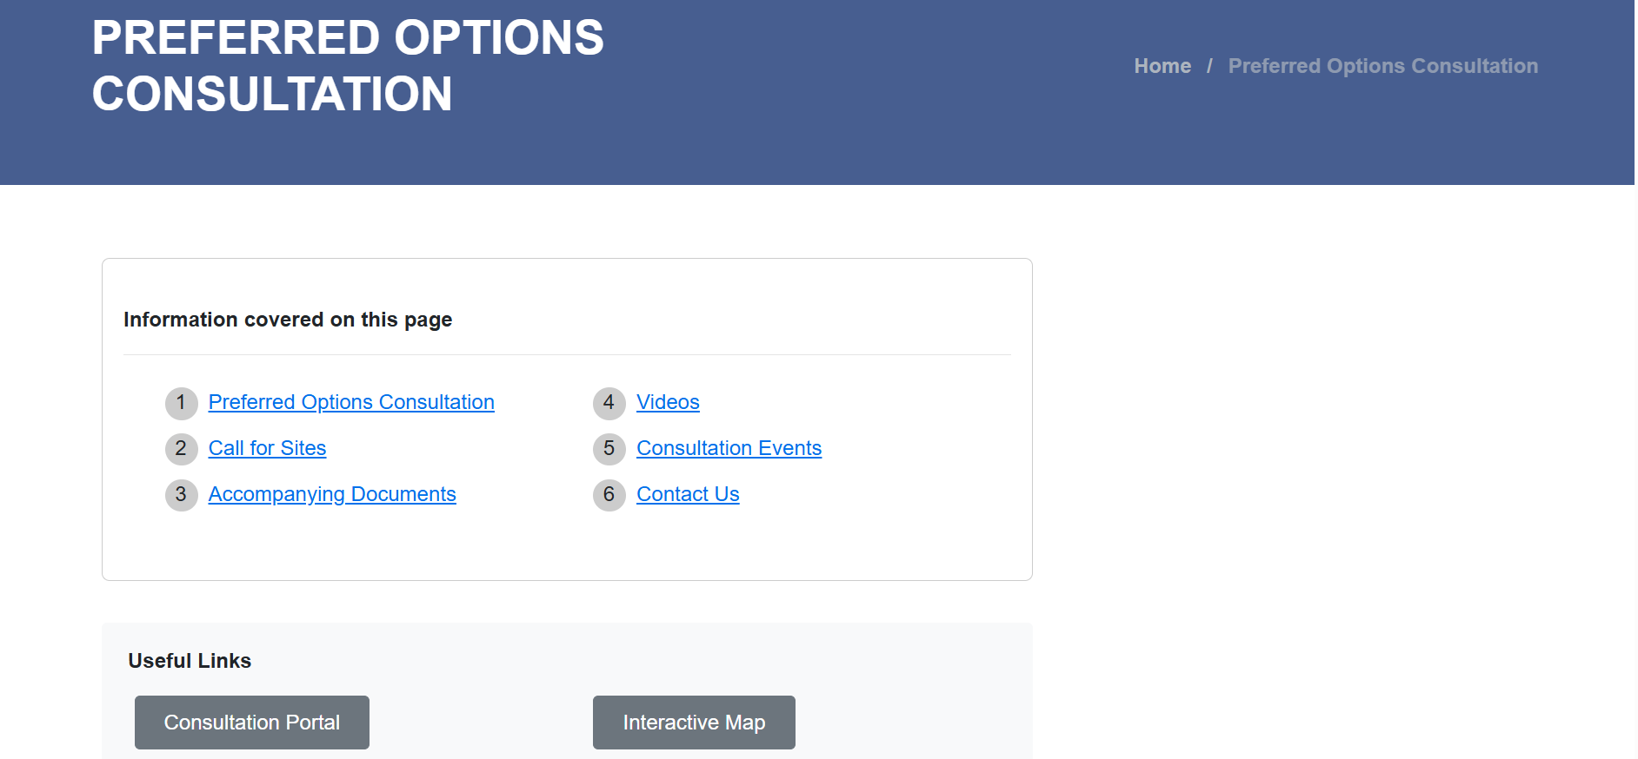

Slide 8
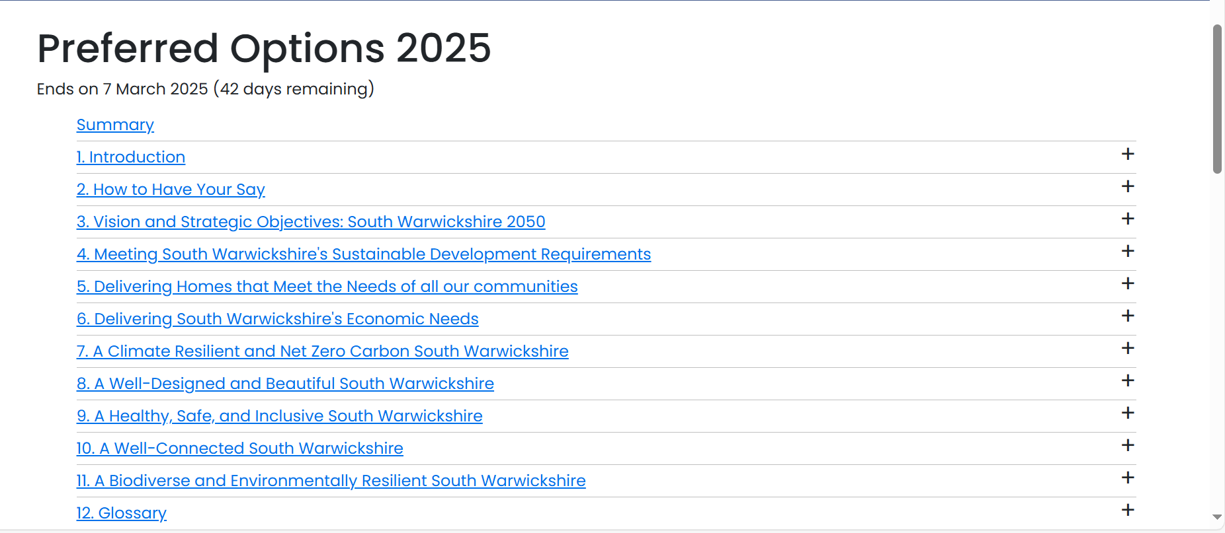

Slide 9
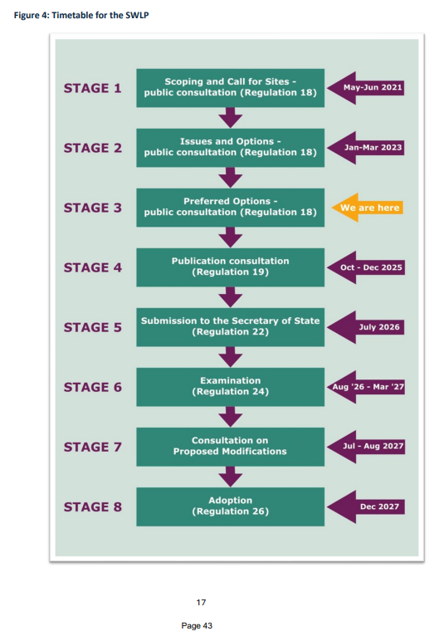

Slide 10
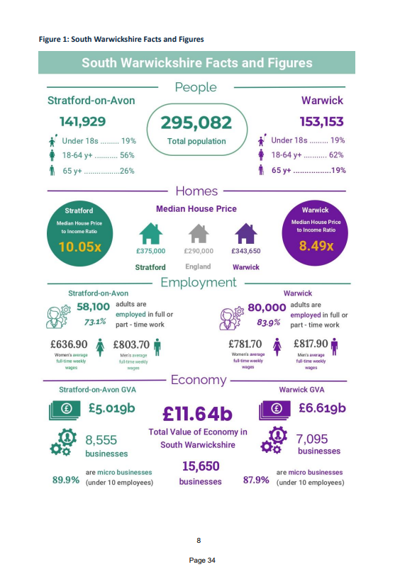

Slide 11
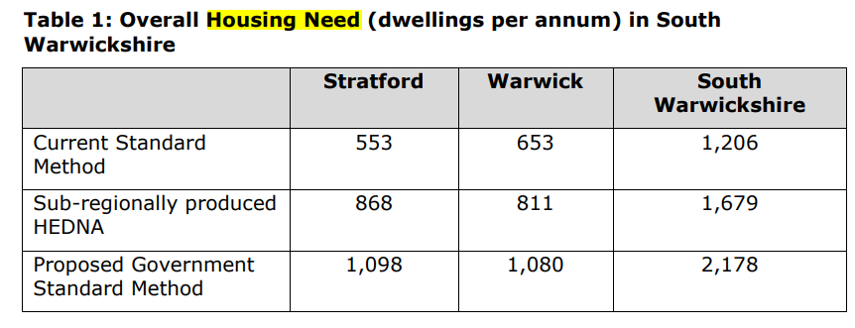

Slide 12
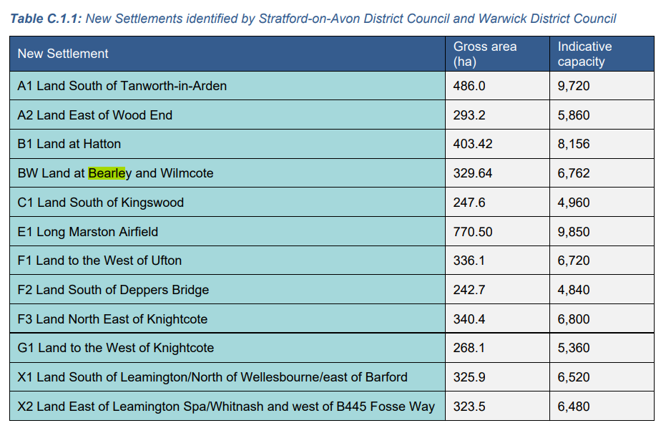

Slide 13
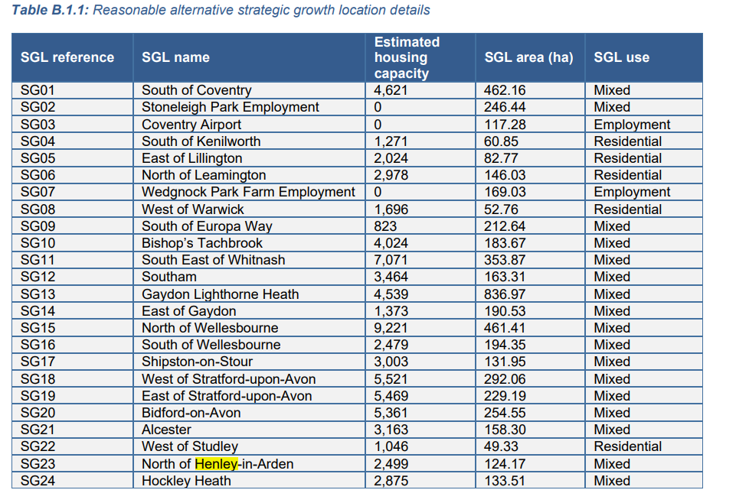

Slide 14
My contact details are below so feel free to contact me if anything is not clear .

Slide 16
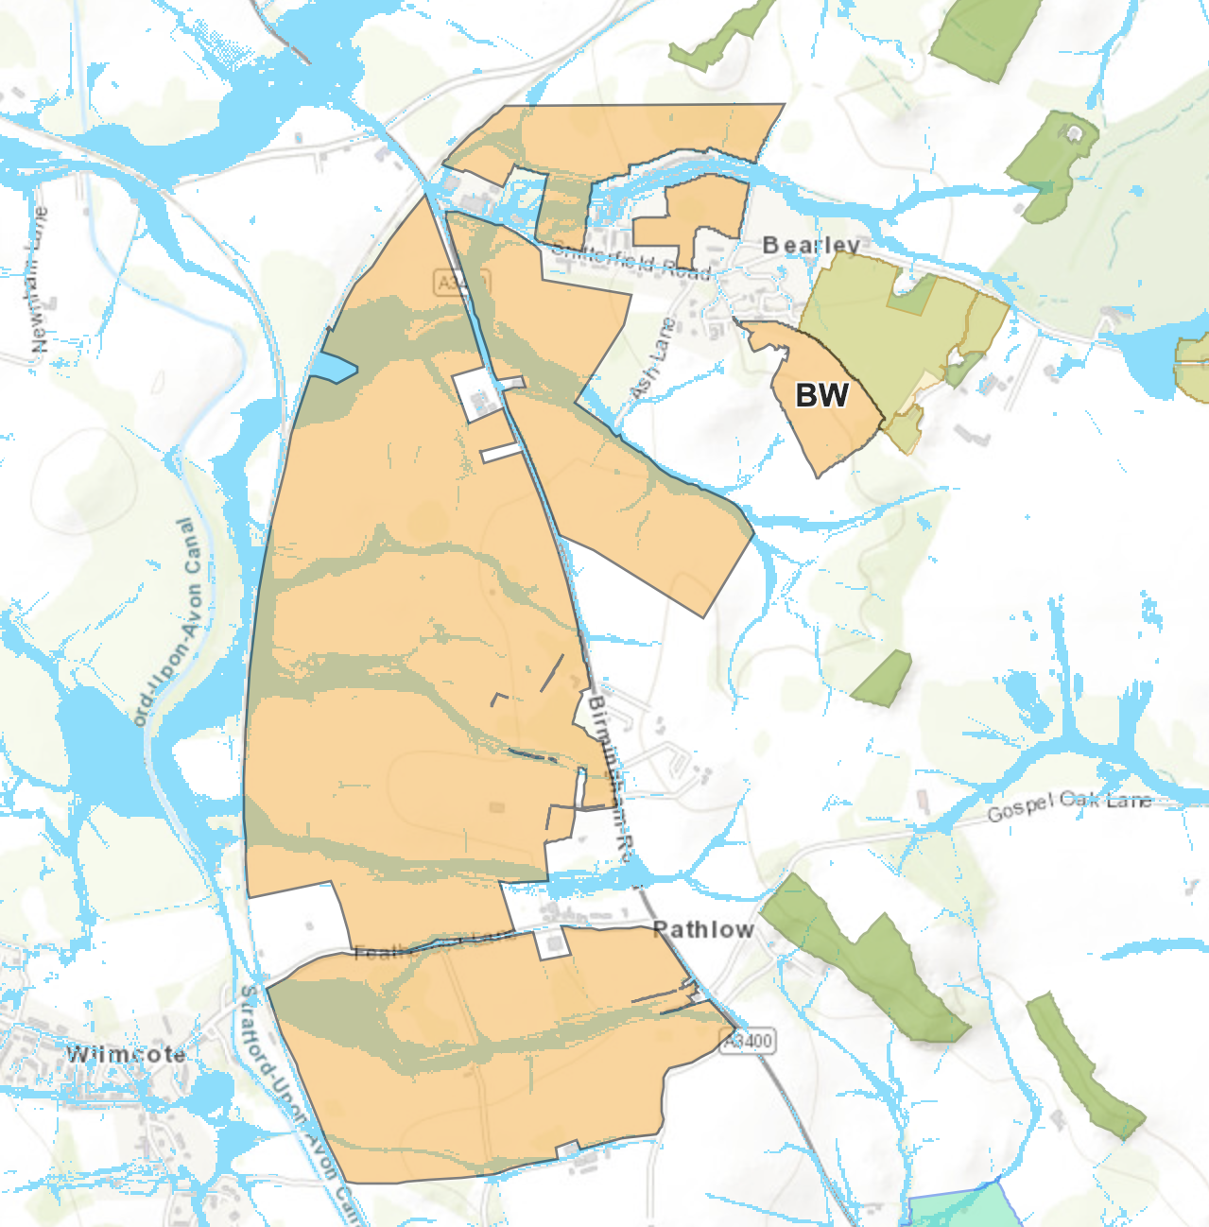
https://soadc.maps.arcgis.com/apps/webappviewer/index.html?id=5a3b9976bd7749a3bff44b2a1016ffc4
Notes:
Show Online map - Online Map - https://soadc.maps.arcgis.com/apps/webappviewer/index.html?id=5a3b9976bd7749a3bff44b2a1016ffc4
Surface flooding areas

Slide 17
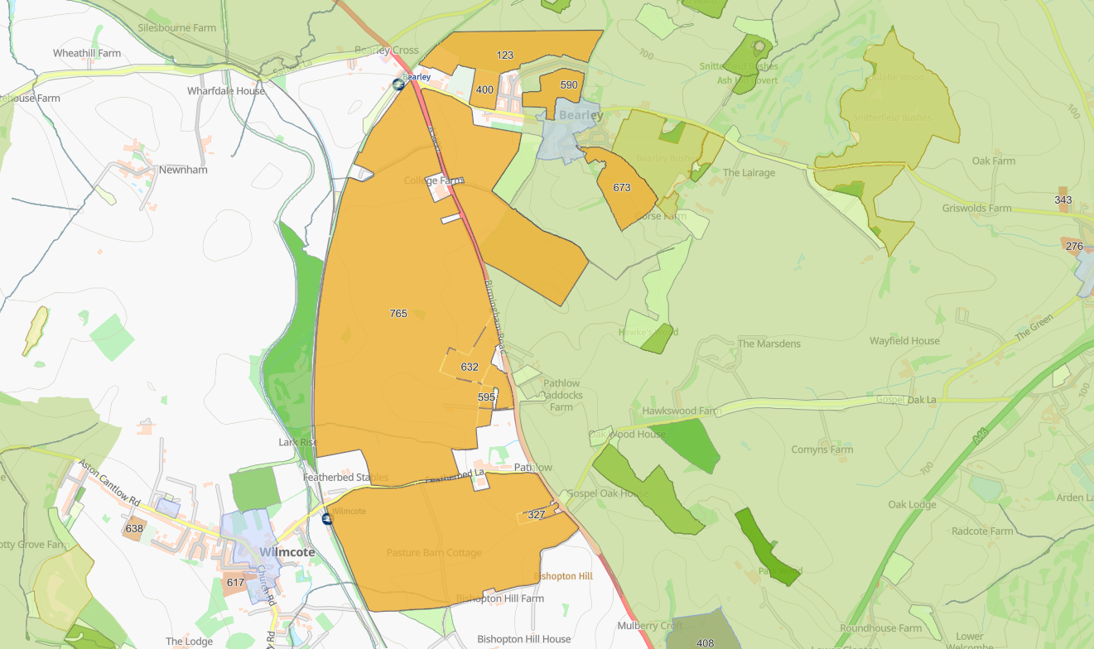
https://soadc.maps.arcgis.com/apps/webappviewer/index.html?id=5a3b9976bd7749a3bff44b2a1016ffc4
Notes:
8 separate sites that have been selected.
The different shades of green indicate areas of ecological interest including bearley bushes which is SSI (site if special scientific interest)
you can see the near st mary church is a conservation areas

Slide 18
BW Sites and Dwelling capacity
Site Ref | Parish | Address | Urban/Non-Urban | Proposed intended use - full | Site Size (sqm) | Site Size (Ha) | Approx capacity (dwellings) | Overall score
123 | Bearley | Snitterfield Road, Bearley | Non-Urban | "Housing/Residential" | 211056 | 21.11 | 422 | 46.60
327 | Wilmcote | Lordswood, Pathlow, Stratford Upon Avon | Non-Urban | "Housing/Residential", "Employment/Industrial/Commercial" | 14129 | 1.41 | 37 | 64.85
400 | Bearley | Land North of Snitterfield Road, Bearley, Stratford upon Avon, CV37 0SB | Non-Urban | "Housing/Residential" | 31258 | 3.13 | 83 | 53.10
590 | Bearley | Oak tree close | Non-Urban | "Housing/Residential" | 55173 | 5.52 | 146 | 39.10
595 | Wilmcote | Loughrigg, Hardwick Rise, Pathlow, Stratford Upon Avon, CV37 0ES | Non-Urban | "Housing/Residential" | 17534 | 1.75 | 46 | 63.10
632 | Wilmcote | New House Farm, Birmingham Road, Pathlow, Stratford Upon Avon | Non-Urban | "Housing/Residential","Employment/Industrial/Commercial","Retail","Leisure/Community", "Open space/Biodiversity/Green Infrastructure","Renewable Energy" | 60312 | 6.03 | 159 | 64.10
673 | Bearley | Bearley Farm, Church Lane, Bearley, Stratford Upon Avon, Warwickshire. | Non-Urban | "Housing/Residential","Renewable Energy" | 97643 | 9.76 | 258 | 53.30
765 | Bearley & Wilmcote | Land at Bearley and Wilmcote | Non-Urban | Mixed | 2813542 | 281.35 | 5627 | 56.87
 |  |  |  |  |  | 330 | 6778
https://www.southwarwickshire.org.uk/swlp/helaa-results.cfm
Notes:
Each site has been access for suitability (against all of the 879 sites put forward)
Overall score (note lower is better)

Slide 19
What about the Green belt…?
Once established, there is no requirement for Green Belt boundaries to be reviewed or changed when plans are being prepared or updated. Authorities may choose to review and alter Green Belt boundaries where exceptional circumstances are fully evidenced and justified, in which case proposals for changes should be made only through the plan-making process. Strategic policies should establish the need for any changes to Green Belt boundaries, having regard to their Intended permanence in the long term, so they can endure beyond the plan period. Where a need for changes to Green Belt boundaries has been established through strategic policies, detailed amendments to those boundaries may be made through nonstrategic policies, including neighbourhood plans’
Notes:
You might be asking how is this being allowed on Green belt land

Slide 20
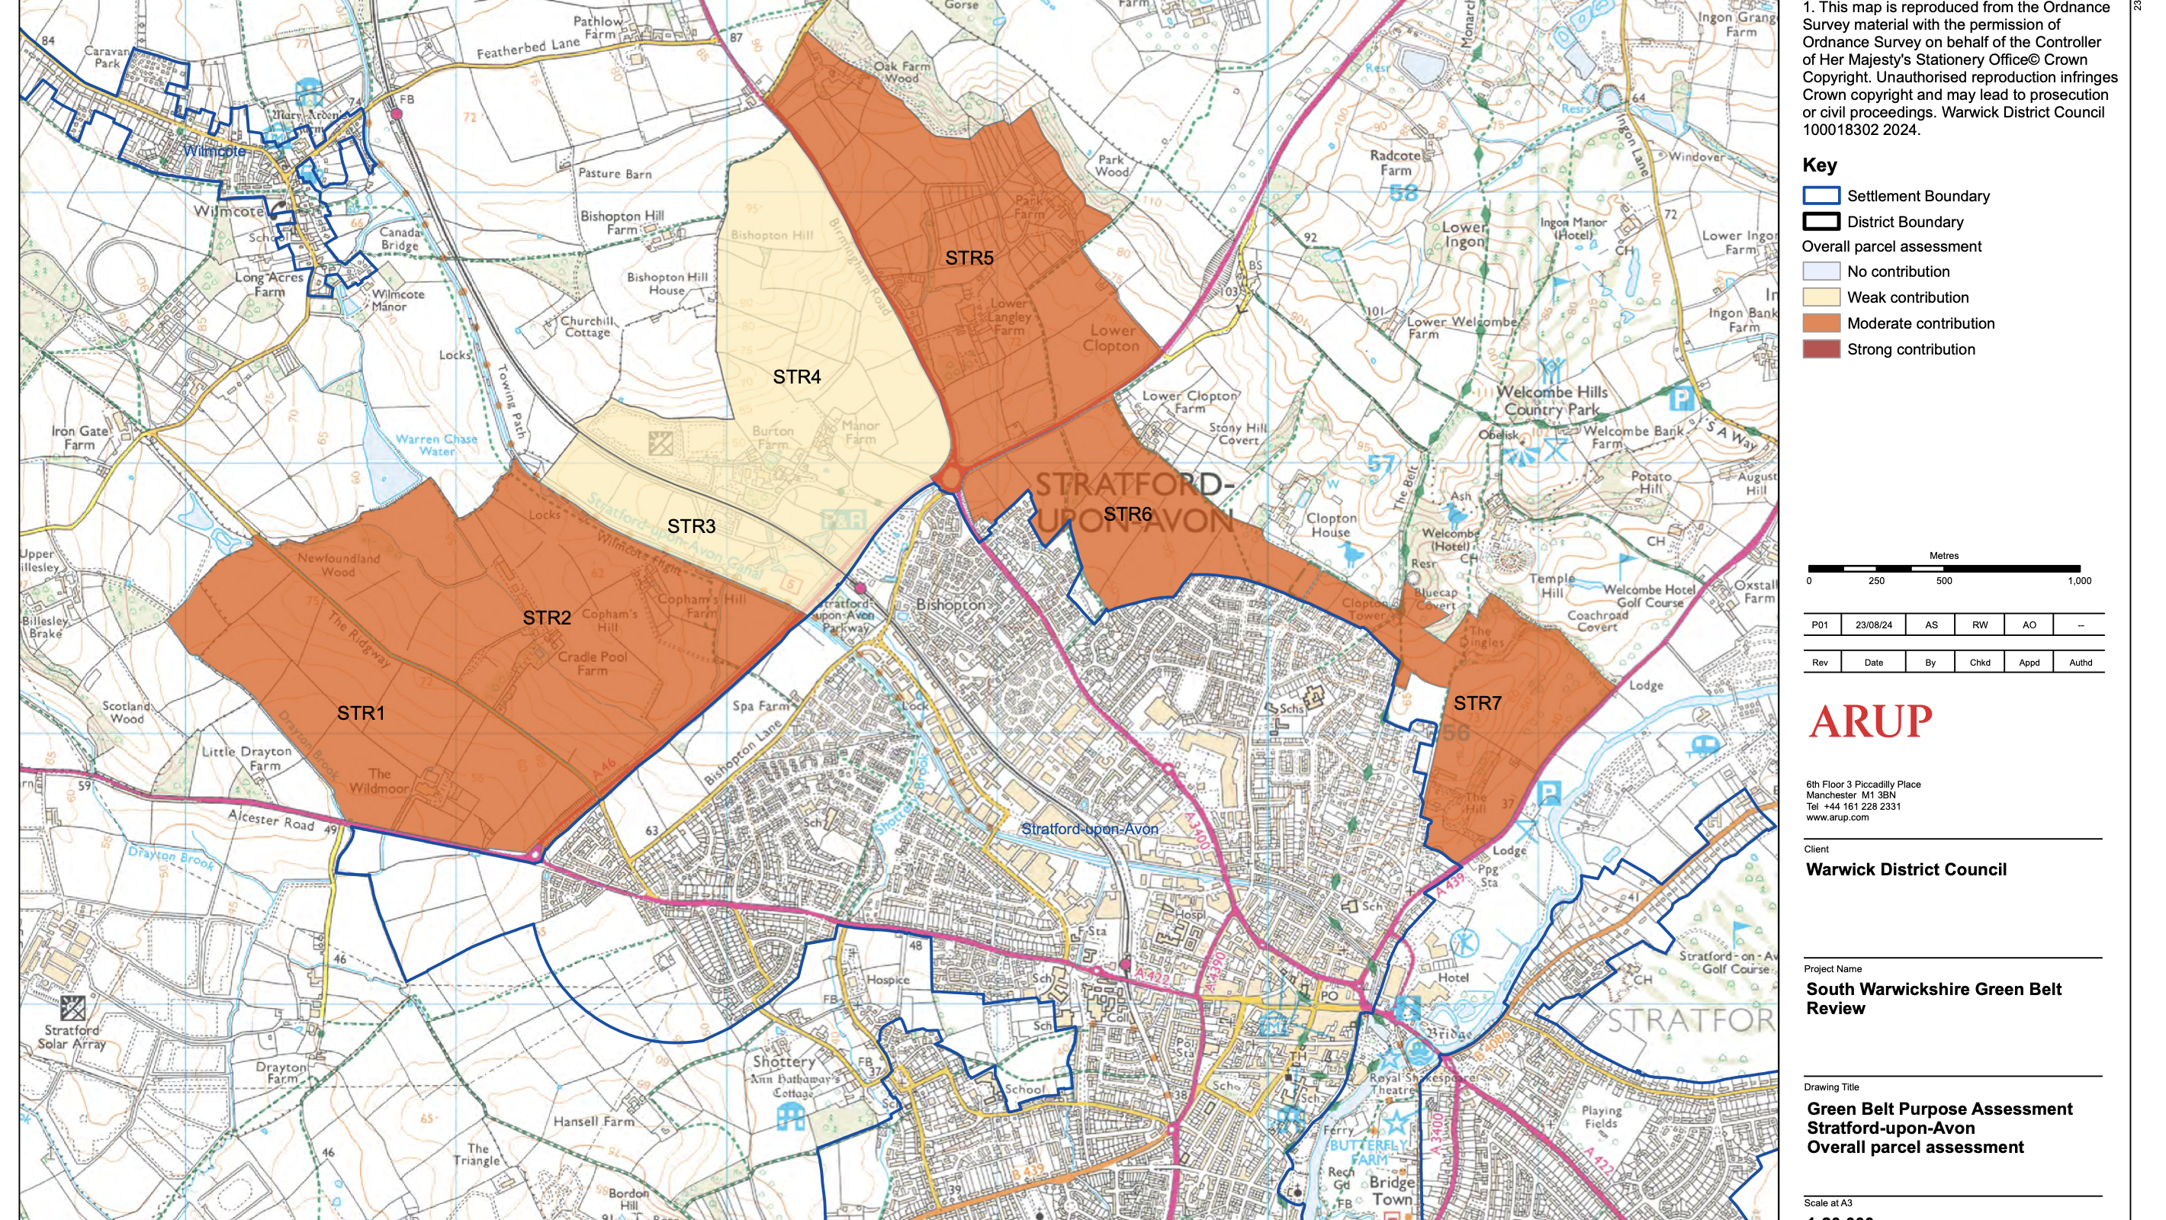
Notes:
A weak contribution to a Green Belt is when a site does not perform well in one or more of the Green Belt's purposes. This could be due to a number of factors, including:
Location: The site is remote from urban areas, or is not near a historic town
Size: The site is too small to make a significant contribution
Infrastructure: The site lacks infrastructure, such as roads or power lines
Alignment with regeneration goals: The site doesn't align with local plans for urban regeneration
Potential for redevelopment: The site has low potential for redevelopment due to its size, location, or lack of infrastructure

Slide 21
Other points to note…
An indicative need for 29 ha of employment land required to support 6,000+ homes
Industrial provision would be best catered for along the eastern and in particular the south- eastern areas of the site where access to the road network is best. Office provision would be best-located nearby to one of the two rail stations.
6,000+ new dwellings would require 1 new secondary and 3-4 new primary schools.
There is a 3rd call for sites in progress….which could extend the site further
Notes:
Some other points to notes regarding the BW site.

Slide 22


